Slide 1
Category: Business Analyst
Name: Raisa Fariha
Email: raisafariha@iut-dhaka.edu

Slide 2
A High Level Design of the Service Flow:

Slide 3
Login to the system
Search for train
Check next arrival time of a train
Customer
Check current location of a train
See current credit balance, total travel history of last 1 month
Available trains and fare
Paper copy of QR Code
give current ticket id and final destination and get new QR code
Choose a destination point
yes
Check availability
Scan QR code at pickup point
want to extend route?
No
Choose a combination
Get out of station
Book bulk credit
Scan QR Code at dropping point
No
Get a QR Code
exceeded deducted credit?
Charge from customer’s credit
Yes
Can’t go out of station

Slide 4
A High Level Architecture of the System:

Slide 5




LOAD BALANCER
Customer
APPLICATION
SERVER
Customers completing payment transaction
Stripe
(Payment)
3rd party services(email and sms)
LOAD BALANCER
Billing system for managing customer’s credit
Billing Server
Handles requests from users
APPLICATION
SERVER
USER
INTERFACE
Confirming ticket purchase
Storing customer’s purchase history
APPLICATION
SERVER
Billing Server
Web Server
Internet
http request/ response
APPLICATION
SERVER
Handles requests from the application along with the web servers
DB Server
DB Server
Web Server

Slide 6
UML Diagram:

Slide 7

Login
<<extend>>
Create account
<<include>>
<<include>>
valid
invalid
Check availability
<<include>>
Search for train on a route
Check fare of different trains
<<include>>
Book ticket
Charged from credit
<<extend>>
USER
<<extend>>
QR Code Issued
Scan QR Code at pickup point
<<include>>
Collect paper copy of QR Code
MOBILE APP
<<include>>
Scan QR Code in dropping point to get out
Not get out if customer exceeded his deducted credit
<<extend>>
give current ticket id and final destination to get a new QR-Code
See current credit balance, total travel history of last 1 month

Slide 8
High Level DB Architecture (ERD):

Slide 9
USERS
user_id(pk)
user_name
user_password
user_location
balance
LOGIN
user_id(fk)
login_id
login_name
login_pass
TRAIN_INFO
train_id(pk)
train_name
train_pickuppoint
train_droppoint
train_arrivaltime
train_departuretime
date
FARE
train_id(fk)
fare_id
fare_name
fare_type
ticket_price
BOOKING_INFO
train_id(fk)
no_of_available_tickets
ticket_id(pk)
date
time
CREDITCARD_INFO
user_id(fk)
card_number(pk)
card_type
expiration_month
expiration_year
PAYMENT_INFO
payment_id
payment_amount
card_number(fk)
ticket_id(fk)
date
time

Slide 10
High Level API Designs (RESTful):

Slide 11
The APIs are as follows:
API name: LoginAPI
Request: {username, password}
Response: {success, COOKIES}
API name: CheckCurrentLocationOfATrain
Request: {TrainName}
Response: {Train Location-(co-ordinates/area city}
API name: GetNextArrivalTrain
Request: {pickup location}
Response: {Train name, Train arrival time}
API name: GetTheNearestTrainLocation
Request: {userlocation}
Response: {Train Location-(co-ordinates/area city}
API name: BookingTrain
Request: {TrainName, Date, Time, NumberOfTickets, destination, PickupPoint}
Response: {Price of the tickets}

Slide 12
API name: ConfirmBooking
Request: {CreditCardNumber, TransactionMoney}
Response: {QR code}
API name: ExtendRouteAPI
Request: {CurrentTicketID, Destination}
Response: {Price, QR Code}
API name: QRCheckerAPI
Request: {QR Code}
Respone: {Success?, Fail/Failure Reason}
API name: CheckBalanceAPI
Request: {username, password}
Response: {Balance in the account}
API name: ScannerCheckerAPI
Request: {QR Code}
Respone: {Success?, Fail/Failure Reason}
API name: PurchaseQRCodeAPI
Response: {CreditCardNumber, TransactionMoney}
Response: {QR code}

Slide 13
TPS (transaction per second) Calculation and required infrastructure:

Slide 14
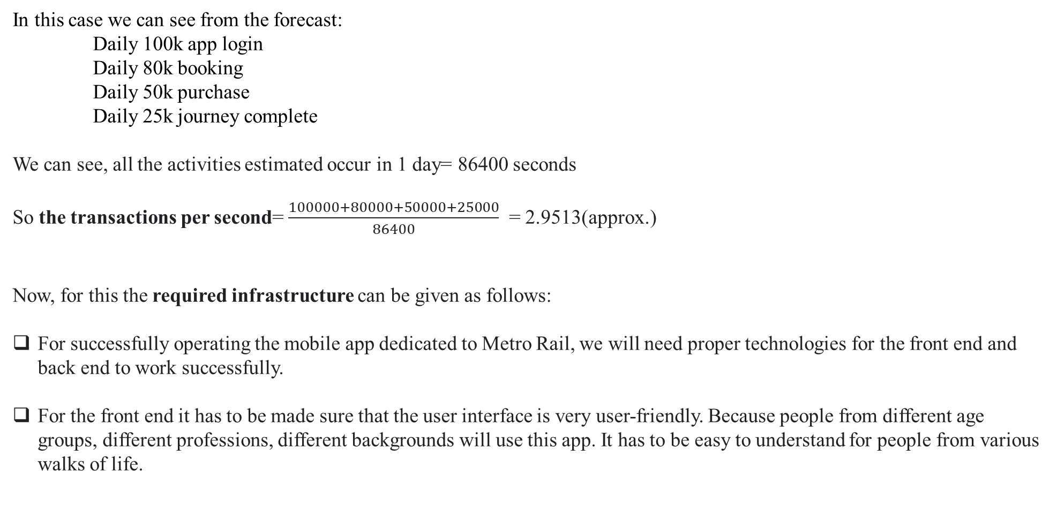
In this case we can see from the forecast:
Daily 100k app login
Daily 80k booking
Daily 50k purchase
Daily 25k journey complete
We can see, all the activities estimated occur in 1 day= 86400 seconds
So the transactions per second= $\frac{100000+80000+50000+25000}{86400}$ = 2.9513(approx.)
Now, for this the required infrastructure can be given as follows:
For successfully operating the mobile app dedicated to Metro Rail, we will need proper technologies for the front end and back end to work successfully.
For the front end it has to be made sure that the user interface is very user-friendly. Because people from different age groups, different professions, different backgrounds will use this app. It has to be easy to understand for people from various walks of life.

Slide 15
For frontend HTML, CSS, Bootstrap can be used so that it is responsive, easily navigable and the design isn’t too complicated.
For storing the information of the users, their login information, user name and so on, also details about the trains, their name, details about their route and timings, fare, database will be required. For example, MySQL, Microsoft SQL Server and so on.
To properly access, modify and delete the information from the database when required, we will need different database languages like SQL, Oracle etc.
We will require a backend server for running the backend codes properly which typically constitutes the requests from the clients and the logic to send the appropriate data in response to that request.
We will require a cloud for hosting the application in order to ensure flexibility and scalability.
For backend we can use python framework like using Django, Laravel etc.
For the ticket scanner to work properly we can use some APIs.

